Slide 1
PASSWORDLESS AUTHENTICATION SCHEME USING SMARTPHONE
Under the Guidance of Presented by
R.DEVI, AP J.VIGNESWARAN -1418152
DEPARTMENT OF IT L.ASADNABI-1418L01
V.SATHEESH-1418L07

Slide 2
OBJECTIVE
A new password less authentication scheme using smart phones is presented which is not only solved a problem of remembering a password and also provide a robust security.
The proposed scheme use International Mobile Equipment Identity(IMEI) number of smartphone with Completely Automated Public Turing Test to Tell Computers and Humans Apart(CAPTCHA) to provide Security also Elliptic Curve Digital Signature Algorithm (ECDSA) is used to ensure the mutual authentication between the user and the server

Slide 3
EXISTING SYSTEM
The various existing password less authentication systems with their drawbacks.
Smartcards :
Need PINs and passwords.
Vulnerable to smartcard lost problem.
Biometric:
Require extra hardware.
Privacy concerns.
Expensive.
OTP & Email :
The time involved in procuring and maintaining hardware tokens.
Incompatibility of software for certain mobile operating systems.
The cost of sending messages using Short Message Service (SMS).

Slide 4
EXISTING SYSTEM
IMEI with CAPTCHA:
Mobile phone IMEI number with CAPTCHA is used instead of password to authenticate the user .
The user is allowed to login and accessed their web accounts only by registered mobile device.
There is no encryption/decryption, digital signature between the client and server.
There are various security issues in this method like Man-in-middle attack, server spoofing can be occurred.
Mobile phone lost/stolen problem

Slide 5
LITERATURE SURVEY
Paper name | Concept | Advantage | Disadvantage
PLA(Password less Authentication) | Verify the user by using IMEI number and user id with master pin . Then it generated the OTP password | Detailed explain about Password authentication OTP Email Authentication Advantage in PLA | Provide method is more complex. User Need to Remember a pin
Password less Login System for Mobile Phones Using CAPTCHA | Instead of using password we use the CAPTCHA with IMEI and also no encryption is done | Password less authentication method based on CAPTCHA Easily Implemented Less Server work | Only CAPTCHA is used Instead of password No encryption is used Easily hacked

Slide 6
LITERATURE SURVEY
Paper name | Concept | Advantage | Disadvantage
A novel password less authentication scheme for smart phone using elliptic curve cryptography. | Encrypt the IMEI number with CAPTCHA using ECDSA signature to authenticate only for smart phone | Provide high security Use resource efficiently | Security only provide for smart phone. Doesn’t suitable for other device
Android application for password less login for web application | Authentication token is stored in the user device whenever user login the system then Authentication token send to the server | Password less authentication Multiple sites Easily used User friendly | Only logged in other device Not suitable for registered device

Slide 7
LITERATURE SURVEY
Paper name | Concept | Advantage | Disadvantage
Multi-level Security using Quadratic Residue(QR) Code, Biometrics and Password for Security Systems | This Method provides multi security with combination of biometric and QR code | Multi level security Biometrics are combined | More Server process High complex More cost
A novel approach for Dynamic Authentication by combining CAPTCHA, graphical Password and OTP in a web enabled system | Authentication is done by OTP was only generated when the CAPTCHA and dynamic password are correctly matched | Provide high Security Combined multiple security Used different type of CAPTCHA. | Need high cost Remember a graphical password portion

Slide 8
PROPOSED SYSTEM
The proposed scheme introduce a new Password less Authentication which relieves users from memorizing long and complicated passwords.
Proposed scheme uses smartphone IMEI number with CAPTCHA and ECDSA to provide security with mutual authentication.
The proposed scheme uses ECDSA which is based on Elliptic Curve Cryptography (ECC) and incorporate with CAPTCHA which play an important role in protecting the web resources from spamming and other malicious activities.
ECC can therefore be efficiently implemented in resource constraint devices like smart phone.

Slide 9
PROBLEM DEFINITION
Today, a large number of people access internet through their smart phones to login to their bank accounts, social networking accounts and various other blogs. Forgetting the passwords is very common among the users.
Our project aims to developing a android application that is used to solving problem of remembering the password .
Provide high security than password based authentication .
User smart phone are used to login their account .

Slide 10
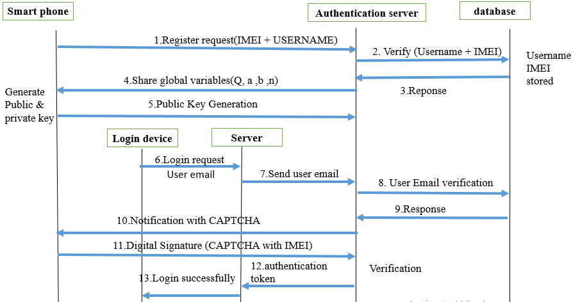
SEQUENCE DIAGRAM

Slide 11
DIFFERENT PHASES
The proposed scheme consist of totally six phases
User Registration phase
Pre computing phase
Login phase
Device changing phase
User eviction phase.
Website phase

Slide 12


USER REGISTRATION PHASE
Database
User name & IMEI
Verify User name & IMEI
Message
Message
Smart Phone
IMEI & user name are not registered then insert into database
Else send an error message
Server

Slide 13
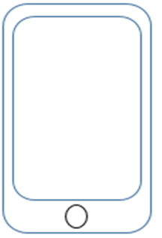
PRECOMPUTATION PHASE
Q, a, b, G, n(share global variable)
H(public key Q,IMEI)
Select Random Number d (private key) from (l , n-l) . Compute Q=G*d;
Server store public key
Server
Smart Phone

Slide 14
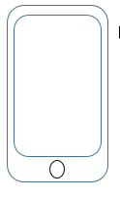
LOGIN PHASE
username
Notification with CAPTCHA
username
H(IMEI ,CAPTCHA,
digital signature)
Authenticated session
Authentication
Token
Server
Login Request
Password less authentication Server verify H(IMEI ,CAPTCHA, digital signature) if all are matched then send token to server
Password less authentication Server verify username
Then send a notification
With CAPTCHA to registered device
Password less authentication server

Slide 15
CONCLUSION
A new password less authentication scheme using smart phones that exploits the advantages of CAPTCHA and ECDSA. CAPTCHAs defend the system against harmful internet bot programs and other malicious activities. In contrast to traditional password based authentication schemes, the users don’t have to worry about password selection and memorizing. The users can easily login from any resource and access the web resources by their smart phone.

Slide 16
REFERENCES
Dr. Sheetal Kalra NOVEL PASSWORDLESS AUTHENTICATION SCHEME FOR SMART PHONES USING ELLIPTIC CURVE CRYPTOGRAPHY , Advances in Engineering: an International Journal (ADEIJ),
Bo Zhu, Xinxin Fan and Guang Gong. Loxin – A Solution to Password-less Universal Login. 2014 IEEE INFOCOM Workshops: 2014 IEEE INFOCOM Workshop on Security and Privacy in Big Data.
Mohammad Shirali-Shahreza, Sajad Shirali-Shahreza. Passwordless Login System for Mobile Phones Using CAPTCHA. 49th International Symposium ELMAR2007, 12-14 September 2007, Zadar, Croatia
Kirit Saelensminde, Prof. Veera Boonjing. A simple password less authentication system for web sites. 2010 Seventh International Conference on Information Technology
J. Bonneau, C. Herley, P. C. van Oorschot, and F. Stajano. The quest to replace passwords: A framework for comparative evaluation of web authentication schemes. In IEEE Symposium on Security and Privacy, SP 2012, 21-23 May 2012, San Francisco, California, USA, pages 553–567, 2012.

Slide 17

ANY QUERIES

Slide 18


